Slide 1
Welcome to Backend Book Club
Microservices with Go by Alexander Shuiskov
Archit Agarwal
Notes:
Hey devs! I’m Archit — I break things so you don’t have to 😅
This is our very first live session, and I’m excited to kick off this journey where we:
✅ Read one backend-focused book together
✅ Discuss it live, every Sunday
✅ Learn from real-world examples, mistakes & memes
📖 Book: *Microservices with Go*
🎥 Format: Weekly YouTube Live — Sundays @ 12PM IST
👨‍💻 Language is Go, but ideas apply to every backend stack!

Slide 2
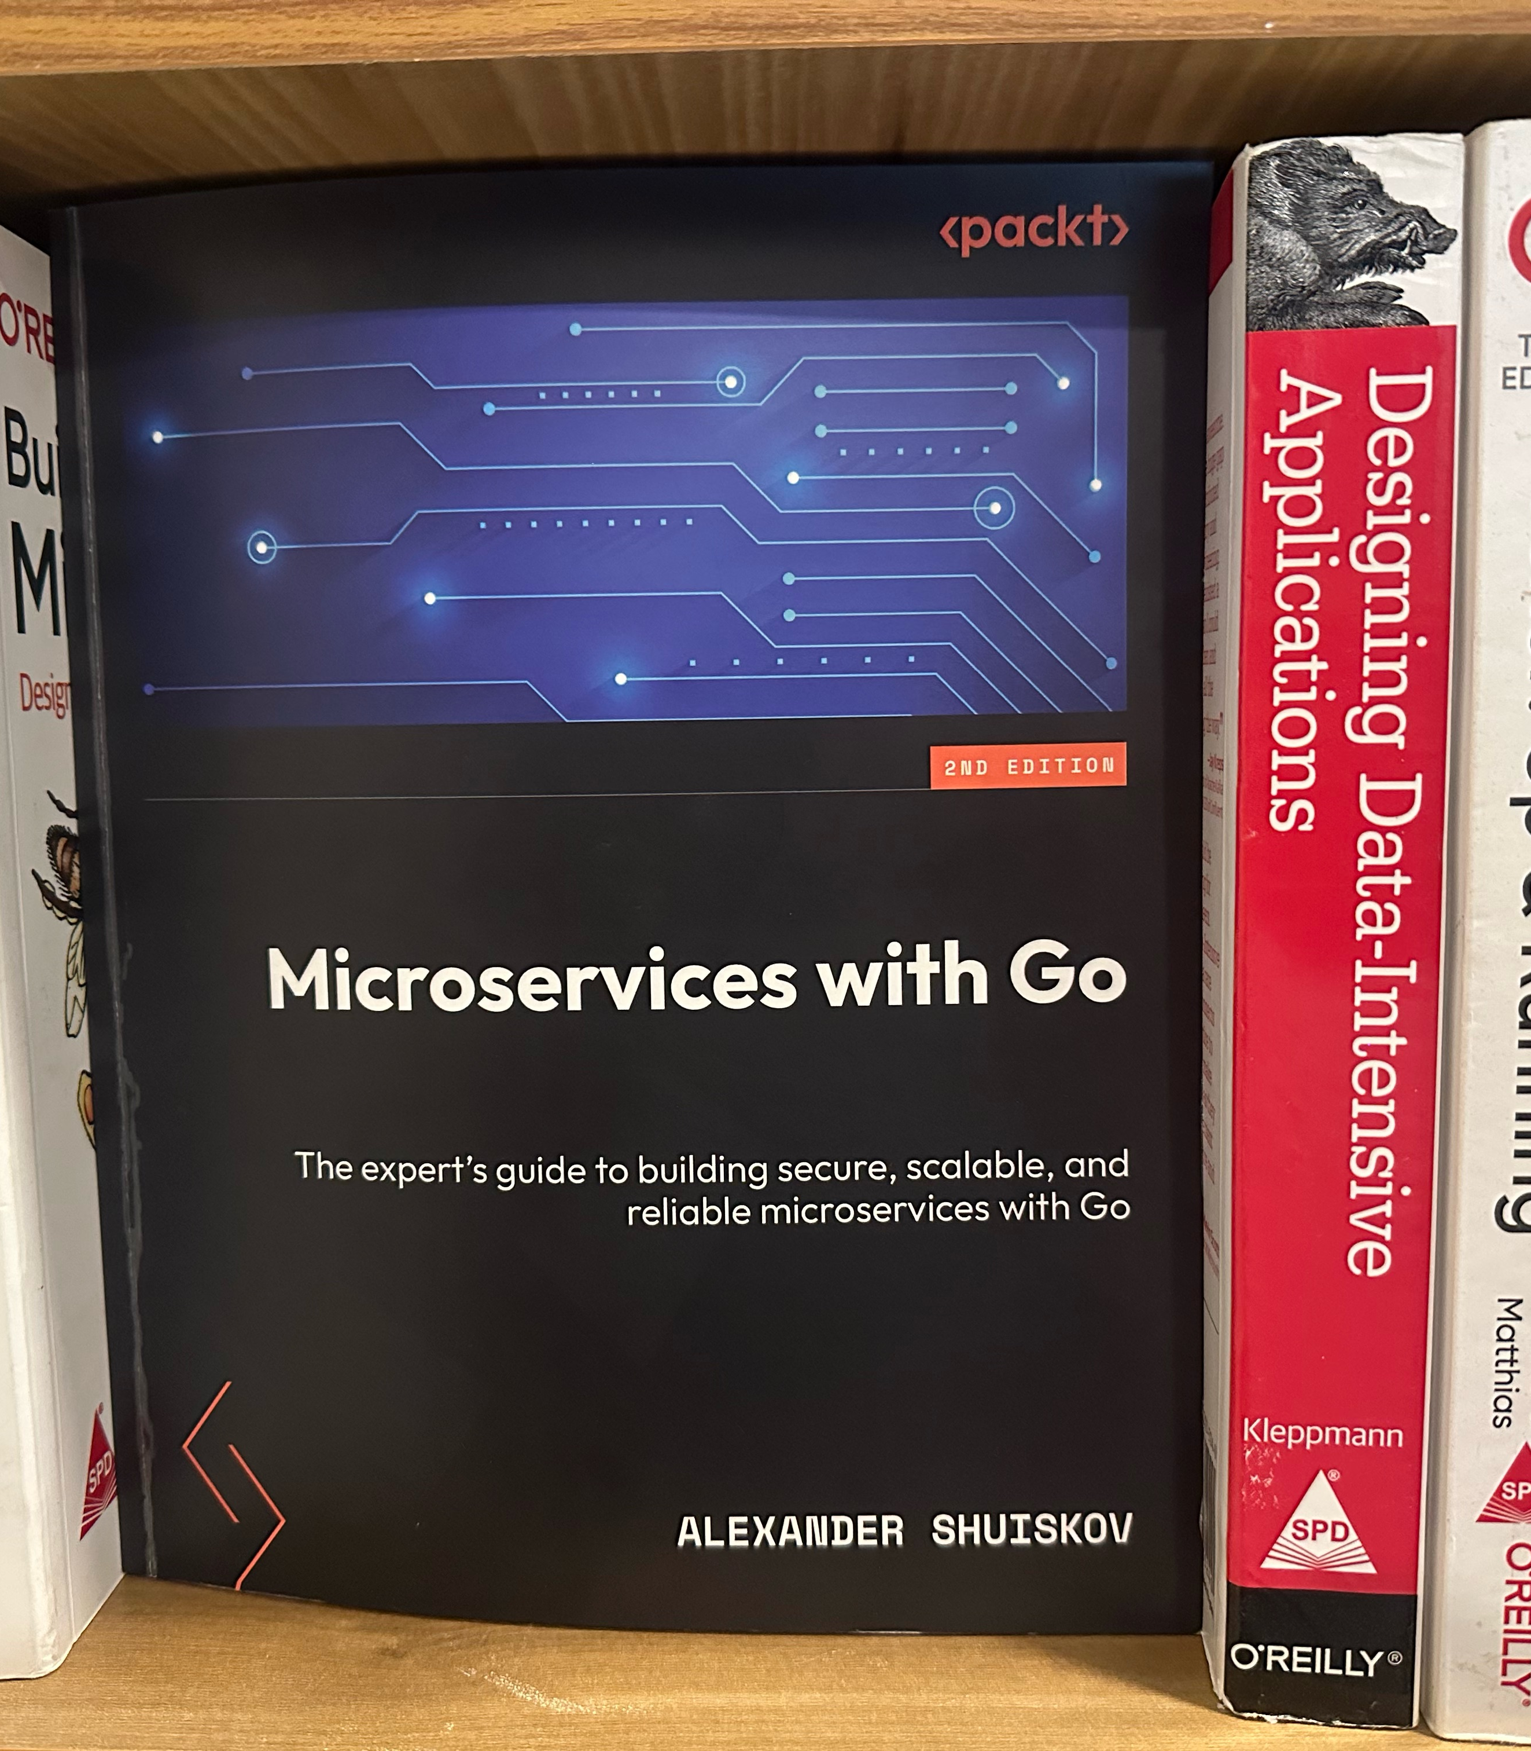
Microservices with Go
2nd edition
🧱 Chapter 1: Monolith vs Microservices
🛠️ Chapter 2: How to structure a backend project
📦 Use Case: Inventory App
🔍 Real-world trade-offs
❓ AMA + What’s next
Notes:
Let’s make this **interactive**. Throw questions in chat! 💬

Slide 3

Monoliths
Not Evil, Just Underappreciated 🧱
Business logic isn’t defined yet
Small team or MVP stage
Need ultra-low latency
Fewer moving parts → Easier to debug
Notes:
💬 If your team is 3 people and you’re debating service discovery, take a deep breath 😅

Slide 4
When Microservices Make Sense
🚀 Need faster deployments
🧪 Different parts need different test rigor
💥 Want fault isolation
🧰 Teams work on different components
🔐 Security/compliance vary per feature
⚙️ Infra/tech stack flexibility
Notes:
⚠️ Remember: You’re not Netflix. Yet. So choose carefully 😎

Slide 5
Microservices
Beautiful Mess or Scalable Bliss? ⚖️
✅ Pros:
Faster builds, isolated testing
Tech stack freedom
Scalability per component
Fault isolation = Less firefighting
⚠️ Cons:
Network overhead
Debugging pain 🔥
Complex CI/CD
Distributed transactions... ouch
Notes:
💡 Engineering is trade-offs, not templates.

Slide 6
Let’s Design
Inventory Backend 🛒
Ask yourself:
Where’s the complexity?
What changes most frequently?
What scales differently?
What needs tight security?
📦 Products with details
🧾 Orders for buy/sell/return
🏷️ Discounts per product
Notes:
👉 Let’s analyze it like real architects.

Slide 7
Should This Be a Microservice? 🤔
Frequent updates to orders?
Do orders need compliance and validation?
Discounts are flexible and low-risk?
Inventory is a read-heavy flow?
Notes:
Verdict: *Split where it makes sense*, not just where it sounds cool 💡

Slide 8
Clean Code Habits That Scale 🧽
Once that are followed commonly
Handle errors before anything else
Clear naming (Don’t repeat package in type names)
Pass the context as the first parameter in the function
Single method interface should have a name as method name followed by `er
E.g. Writer interface only has the Write function
Notes:
💬 Language is syntax. Quality is a mindset.

Slide 9
Clean Code Habits That Scale 🧽
Once they are not followed commonly
Wrap errors for context
Don’t panic — literally
Don’t leak context into structs
Test public interfaces, not internals
Notes:
💬 Language is syntax. Quality is a mindset.

Slide 10
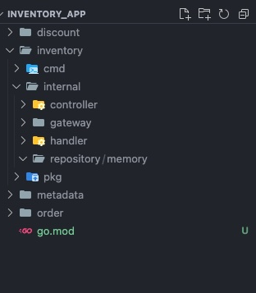
Backend Folder Structures
That makes sense 📦
🏗️ Basic layout:
`cmd/` — app entry points
`internal/` — private app logic
`pkg/` — reusable stuff
`api/` — OpenAPI or gRPC specs
`testdata/` — testing data
`web/` — web application assets
`scripts/`, `configs/`, `deploy/`, etc.
Notes:
Pro Tip: Use the same layout for every service → Cognitive savings!

Slide 11
Let’s Wrap It Up 🎉
Microservices ≠ default choice — make the call deliberately
Monoliths are great for speed & iteration
Structure your backend for readability, not just elegance
Idiomatic = Less WTFs per minute
Notes:
📌 Homework: Think about your last project — if you *had* to split it, where would you start?
Tag me on X/LinkedIn with your thoughts! #BackendBookClub

Slide 12
AMA + Coming Up Next 🚀
Next Sunday @ 12PM IST:
📘 Chapter 3: Service Discovery
🛠️ Chapter 4: Serialisation
❓ Ask Me Anything — drop it in chat!
🎯 Don’t forget to subscribe & share with your team ❤️
Notes:
Until next week — *Keep scaling responsibly!*
And also do not forget to fork the repo and complete the application in your way. I will try to review all and review the code, also I will merge the one that is good.

